Slide 1
Osteoporosis

Slide 2
Institutional Affiliation
Professor’s Names
Student’s Name
Date

Slide 3
Introduction
Osteoporosis is one of the most common kinds of metabolic bone disease.
Osteoporosis disorder causes bones to turn out to be brittle and weak, so fragile that a tumble or even slight stresses like the twisting over or sneezing can cause a break.
Osteoporosis associated fractures most generally happen in the spine, wrist or hip. According to Ralston and Uitterlinden (2010), osteoporosis occurs when the formation of new bone doesn't hold up with the damage of old bone.
This disorder affects both women and men of all ethnic groups. But white and Asian women, especially older women past menopause, are at the highest risk.
Notes:
Osteoporosis is one of the most common kinds of metabolic bone disease. Osteoporosis disorder causes bones to turn out to be brittle and weak, so fragile that a tumble or even slight stresses like the twisting over or sneezing can cause a break. Osteoporosis associated fractures most generally happen in the spine, wrist or hip. According to Ralston and Uitterlinden (2010), osteoporosis occurs when the formation of new bone doesn't hold up with the damage of old bone. This disorder affects both women and men of all ethnic groups. But white and Asian women, especially older women past menopause, are at the highest risk. Treatment, weight-bearing and healthy diet exercise may aid in preventing bone damage or fortify previously weak bones.

Slide 4
Symptoms
There characteristically are no indicators or symptoms in the initial stages of bone injury. But when one’s bones have been deteriorated by osteoporosis, the affected person starts to develop symptoms that comprise:
A bone that fractures more quickly than anticipated.
A curved posture.
Back pain, triggered by a broken or distorted vertebra.
Loss of height over time.
Notes:
There characteristically are no indicators or symptoms in the initial stages of bone injury. But when one’s bones have been deteriorated by osteoporosis, the affected person starts to develop symptoms that comprise:
➢ A bone that fractures more quickly than anticipated.
➢ A curved posture.
➢ Back pain, triggered by a broken or distorted vertebra.
➢ Loss of height over time.

Slide 5
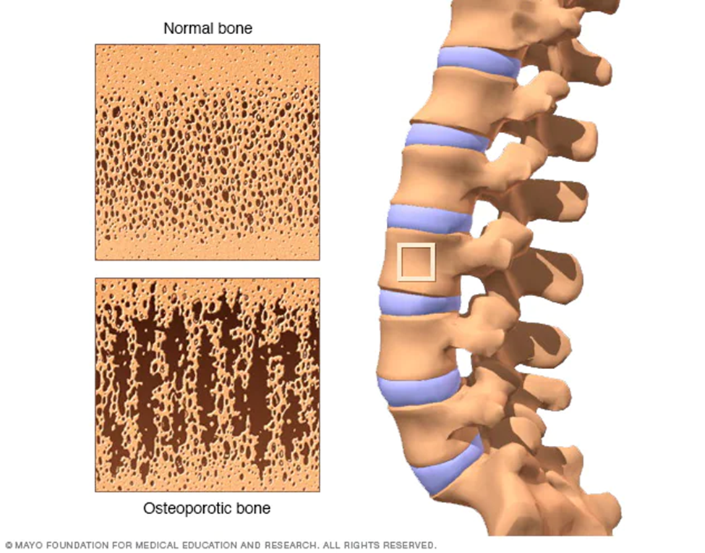

Slide 6
Causes
A lifetime lack of calcium plays a cause in the growth of osteoporosis.
Low calcium consumption contributes to reduced bone compactness, premature bone loss and an increased risk of ruptures—eating disorders.
Strictly limiting food intake and being malnourished deteriorates bone in women and men (Sözen et al., 2017).
Notes:
A lifetime lack of calcium plays a cause in the growth of osteoporosis. Low calcium consumption contributes to reduced bone compactness, premature bone loss and an increased risk of ruptures—eating disorders. Strictly limiting food intake and being malnourished deteriorates bone in women and men (Sözen et al., 2017).

Slide 7
Risk factors
Several issues can upsurge the chances that someone may develop osteoporosis, including someone’s race, age, medical circumstances, treatments, and lifestyle choices.
Unalterable risks
Some risk issues for osteoporosis can’t be controlled, which includes:
Sex. Females are more likely to suffer from osteoporosis disorder as opposed to men.
Age. Older individuals are at a higher risk of suffering from osteoporosis.
Race. Asian descent and white individuals are the people know to suffer from osteoporosis as compared to other people.
Family history. Being born from a parent with a history of osteoporosis puts someone at higher risk, mainly if your father or mother had broken a hip.
Notes:
Risk factors
Several issues can upsurge the chances that someone may develop osteoporosis, including someone’s race, age, medical circumstances, treatments, and lifestyle choices.
Unalterable risks
Some risk issues for osteoporosis can’t be controlled, which includes:
➢Sex. Females are more likely to suffer from osteoporosis disorder as opposed to men.
➢Age. Older individuals are at a higher risk of suffering from osteoporosis.
➢Race. Asian descent and white individuals are the people know to suffer from osteoporosis as compared to other people.
➢Family history. Being born from a parent with a history of osteoporosis puts someone at higher risk, mainly if your father or mother had broken a hip.

Slide 8
Prevention of osteoporosis
Individual lifestyle and diet are two vital risk features you can monitor to prevent osteoporosis.
Replacement of lost estrogen with hormone treatment also offers strong protection against osteoporosis in postmenopausal females.
A good diet and frequent exercise are essential for keeping a person’s bones strong throughout their lifetime (Harvey et al., 2010).
Notes:
Prevention of osteoporosis
Individual lifestyle and diet are two vital risk features you can monitor to prevent osteoporosis. Replacement of lost estrogen with hormone treatment also offers strong protection against osteoporosis in postmenopausal females. A good diet and frequent exercise are essential for keeping a person’s bones strong throughout their lifetime (Harvey et al., 2010).

Slide 9
Treatment
Treatments for recognized osteoporosis may consist of exercise, minerals and vitamins and increases, and medications.
Supplementation and exercise are frequently recommended to help in preventing osteoporosis.
Weightiness, resistance, and balance workouts are all vital (Tu et al., 2018).
Notes:
Treatment
Treatments for recognized osteoporosis may consist of exercise, minerals and vitamins and increases, and medications. Supplementation and exercise are frequently recommended to help in preventing osteoporosis. Weightiness, resistance, and balance workouts are all vital (Tu et al., 2018).

Slide 10
Conclusion
Osteoporosis is a severe disease that affects a considerable percentage of the population.
Regrettably, this disorder is habitually a silent illness since patients naturally do not show out the symptoms and signs till they experience an unfortunate occurrence, like a bone breakage.
Patients and clinicians must comprehend the factors that increase the risk for emerging osteoporosis.
Notes:
Conclusion
Osteoporosis is a severe disease that affects a considerable percentage of the population. Regrettably, this disorder is habitually a silent illness since patients naturally do not show out the symptoms and signs till they experience an unfortunate occurrence, like a bone breakage. Patients and clinicians must comprehend the factors that increase the risk for emerging osteoporosis.

Slide 11
References
Harvey, N., Dennison, E., & Cooper, C. (2010). Osteoporosis: impact on health and economics. Nature Reviews Rheumatology, 6(2), 99-105.
Ralston, S. H., & Uitterlinden, A. G. (2010). Genetics of osteoporosis. Endocrine Reviews, 31(5), 629-662.
Sözen, T., Özışık, L., & Başaran, N. Ç. (2017). An overview and management of osteoporosis. European journal of rheumatology, 4(1), 46.
Tu, K. N., Lie, J. D., Wan, C. K. V., Cameron, M., Austel, A. G., Nguyen, J. K., ... & Hyun, D. (2018). Osteoporosis: a review of treatment options. Pharmacy and Therapeutics, 43(2), 92.

